Slide 1
Artificial Neural Network
(BPNN Derivation)

Slide 2
Content
BPNN Derivation

Slide 3
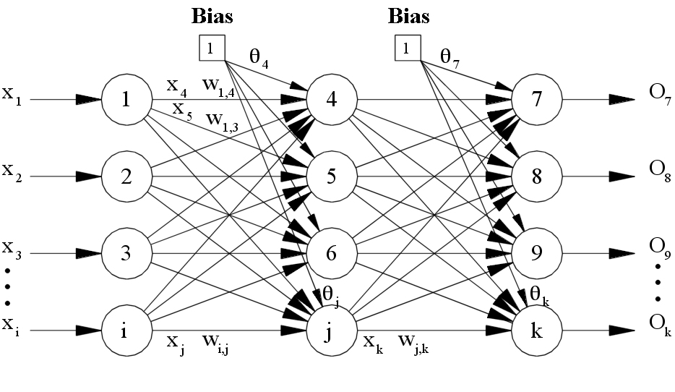
BPNN Derivation

Slide 4
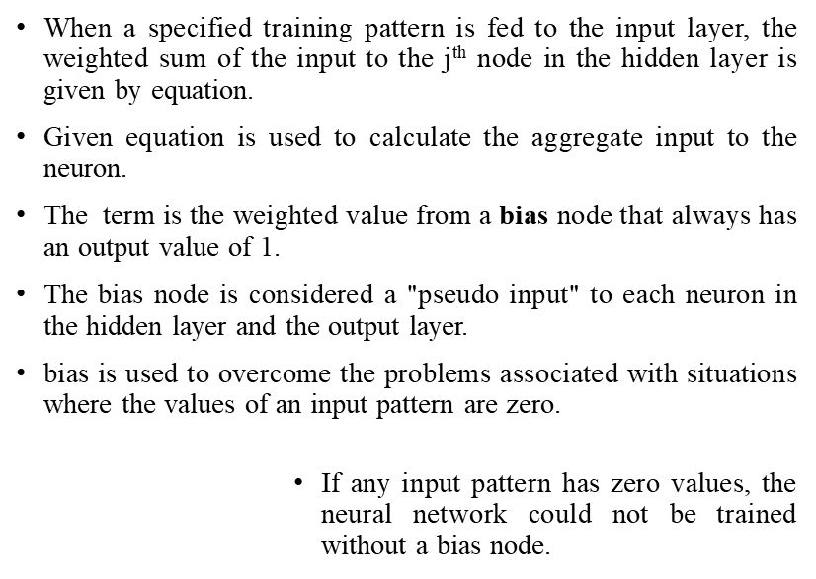
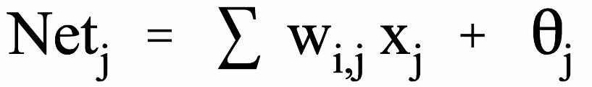
Input Feed-Forward

Slide 5
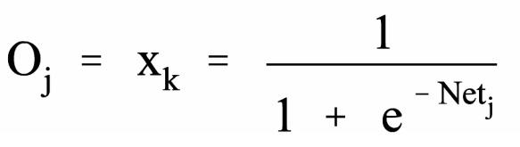
Output
To decide whether a neuron should fire, the "Net" term, also known as the action potential, is passed onto an appropriate activation function.
The resulting value from the activation function determines the neuron's output, and becomes the input value for the neurons in the next layer connected to it..
Since one of the requirements for the Backpropagation algorithm is that the activation function is differentiable, a typical activation function used is the Sigmoid equation
Similarly, equations (1) and (2) are used to determine the output value for node k in the output layer.

Slide 6


Error Calculations and Weight Adjustments - Backpropagation
If the actual activation value of the output node, k, is O_{k}, and the expected target output for node k is t_{k}, the difference between the actual output and the expected output.
The error signal for node k in the output layer can be calculated where the O_{k}(1-O_{k}) term is the derivative of the Sigmoid function.
With the delta rule, the change in the weight connecting input node j and output node k is proportional to the error at node k multiplied by the activation of node j.

Slide 7
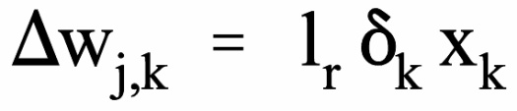
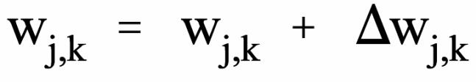
Error Calculations and Weight Adjustments - Backpropagation
The formulas used to modify the weight, w_{j,k}, between the output node, k, and the node, j is:
where is the change in the weight between nodes j and k, l_{r} is the learning rate.
The learning rate is a relatively small constant that indicates the relative change in weights.
If the learning rate is too low, the network will learn very slowly, and if the learning rate is too high, the network may oscillate around minimum point.

Slide 8

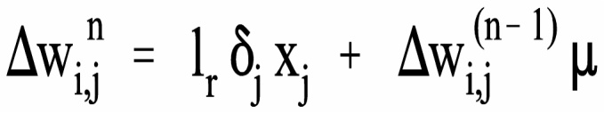
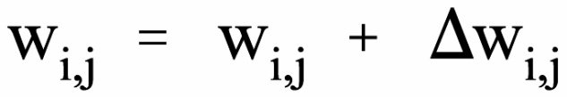
Hidden Layer
The error signal for node j in the hidden layer can be calculated as
where the Sum term adds the weighted error signal for all nodes, k, in the output layer.
As before, the formula to adjust the weight, w_{i,j}, between the input node, i, and the node, j is:
Finally, Backpropagation is derived by assuming that it is desirable to minimize the error on the output nodes over all the patterns presented to the neural network.

Slide 9

Global Error
The following equation is used to calculate the error function, E, for all patterns.
Ideally, the error function should have a value of zero when the neural network has been correctly trained. This, however, is numerically unrealistic.

Slide 10
Thank
You

